Slide 1
PART OF SPEECH (POS) TAGGING FOR HINDI LANGUAGE
Presented By-
Devashish Katoriya
Bhushan Shilawat
Ashutosh Bhawsar
Ninad Kapadnis
K. K. Wagh Institute of Engineering Education and Research, Nashik

Slide 2
Introduction
The task of assigning POS tags to words
Selecting among more than one tags that apply.
Can be used for further NLP tasks.
Identifying Meaning, getting information etc.

Slide 3
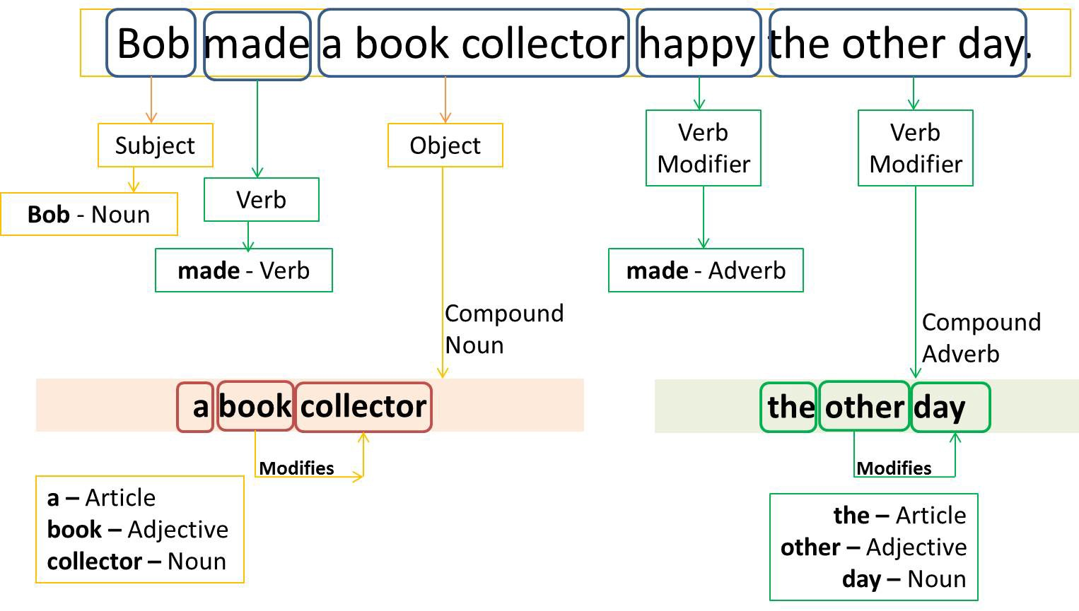
Example of POS Tagging

Slide 4
Motivation
Lack of significant tools for Indian languages
Dependence of other NLP activities on PoS tagging

Slide 5
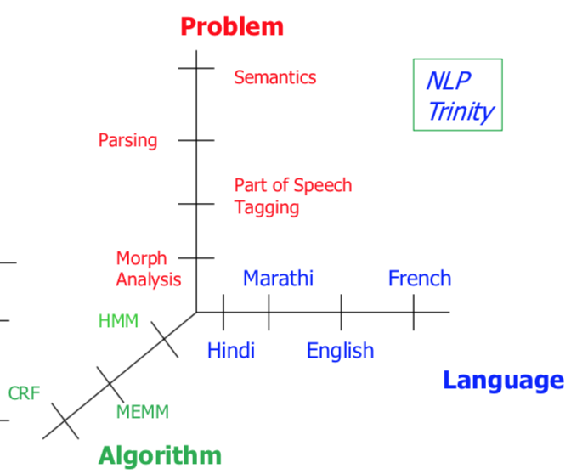
Hurdles in POS Tagging

Slide 6
Need for Taggers for Hindi
The existing taggers fail on Indian languages
The grammatical structure differs from sentence to sentence
Free word structure of Hindi

Slide 7
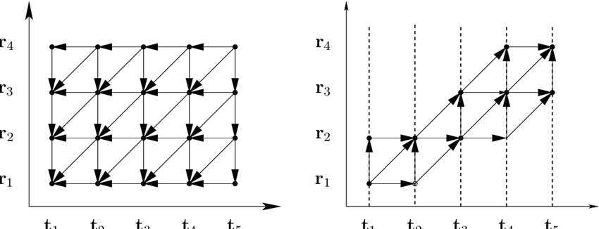
Algorithm
Viterbi Algorithm.
It generates a path, which is a sequence of states which in turn generate the observations.

Slide 8
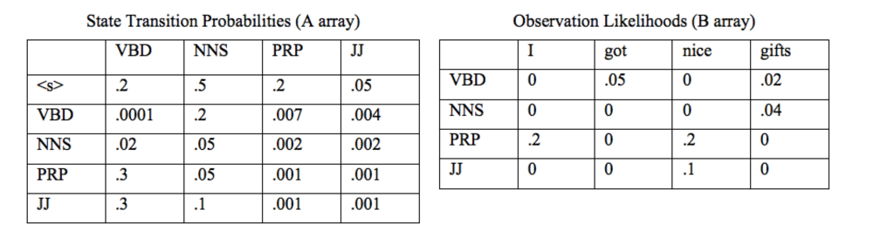
Viterbi Algorithm
Transmission and Emission Matrices:

Slide 9
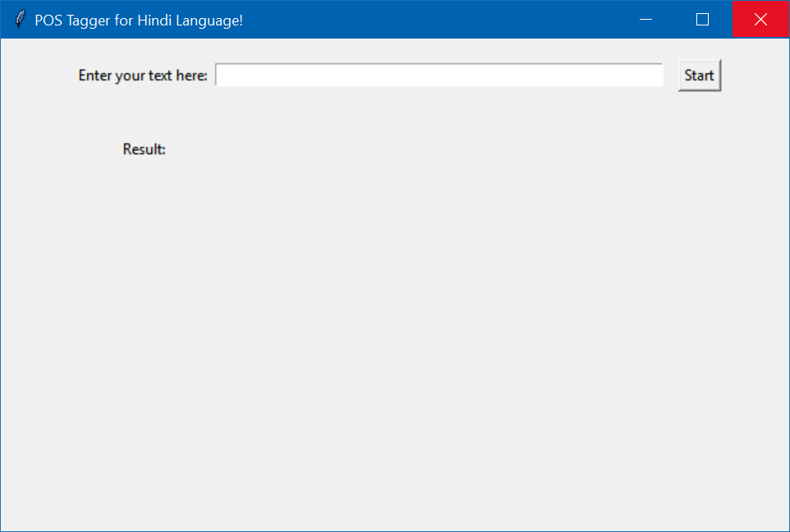
GUI
Fig: Home Screen

Slide 10
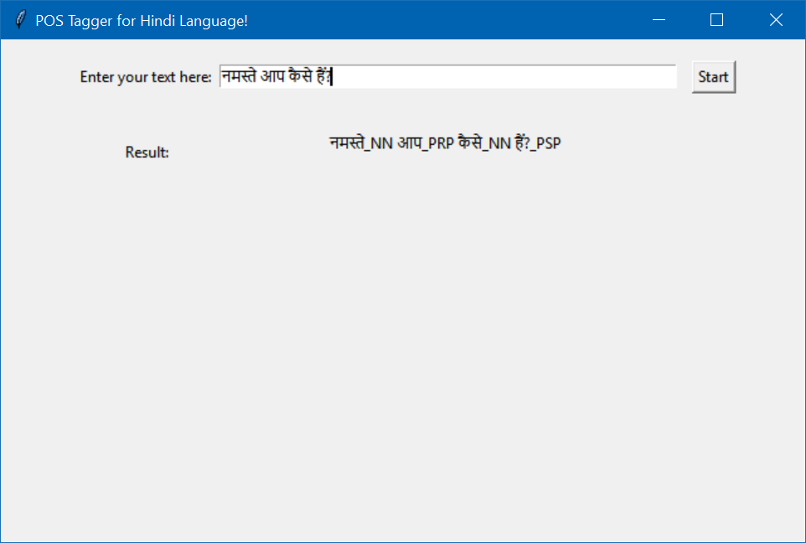
GUI
Fig: Displaying the result

Slide 11
Thank you

